Slide 1
Advancing ITS AMS Through Community Action: A 21st Century Perspective
Karl Wunderlich, Ph.D.
Director, Surface Transportation Systems
Director, Autonomous Systems Research Center
2 December 2025

Slide 2

AMS Community Building: Impact (and Implications) of the Next Generation Simulation (NGSIM) Program
USDOT Program (2001-2008) addressing fundamental issues in the quality of traffic simulation
FHWA Office of Operations and Office of Operations R&D and the USDOT ITS JPO
In the 2000s, the NGSIM program marked a fundamental change in federal role in traffic simulation from model developer to market facilitator
Created an NGSIM Community of simulation software vendors, practitioners, and academics
Decades later, NSGIM program still relevant because of the long-standing impact of the vehicle trajectory data sets collected and shared

Slide 3
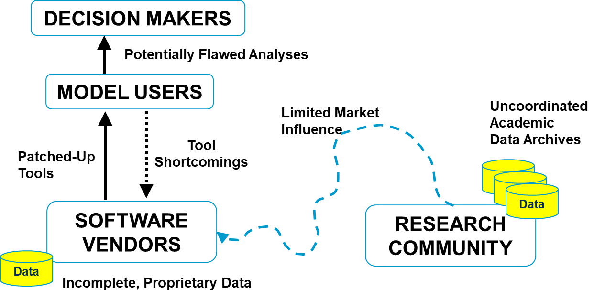
Pre-NGSIM Program ITS AMS Market: Fundamental Flaws

Slide 4
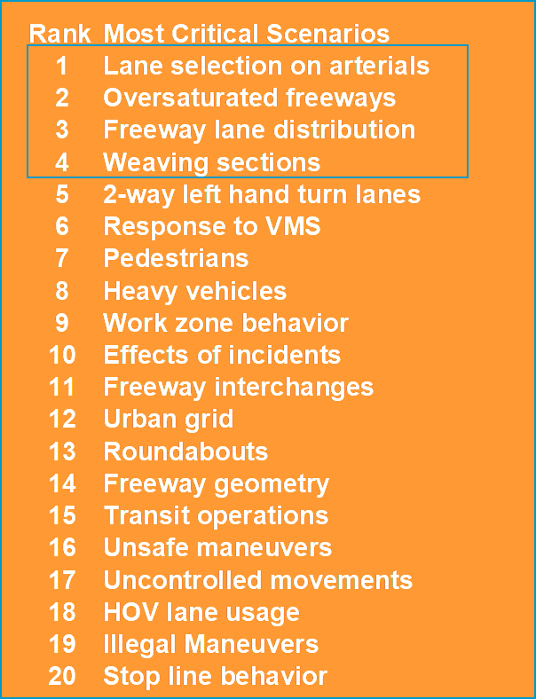
NGSIM Algorithm Prioritization
March 2003 Community Stakeholder Workshop
35+ critical scenarios* identified by users where current tools are deficient
Poor accuracy under congested conditions was a pervasive concern
NGSIM program focus: Top 4 critical scenarios
Collect comprehensive, all vehicle trajectory data with cameras mounted neighboring tall buildings
Key merge/weave and arterial intersections
Capture development and dissipation of congestion over 45 minutes
* 35 tactical scenarios plus separate list of strategic traveler choice scenarios

Slide 5
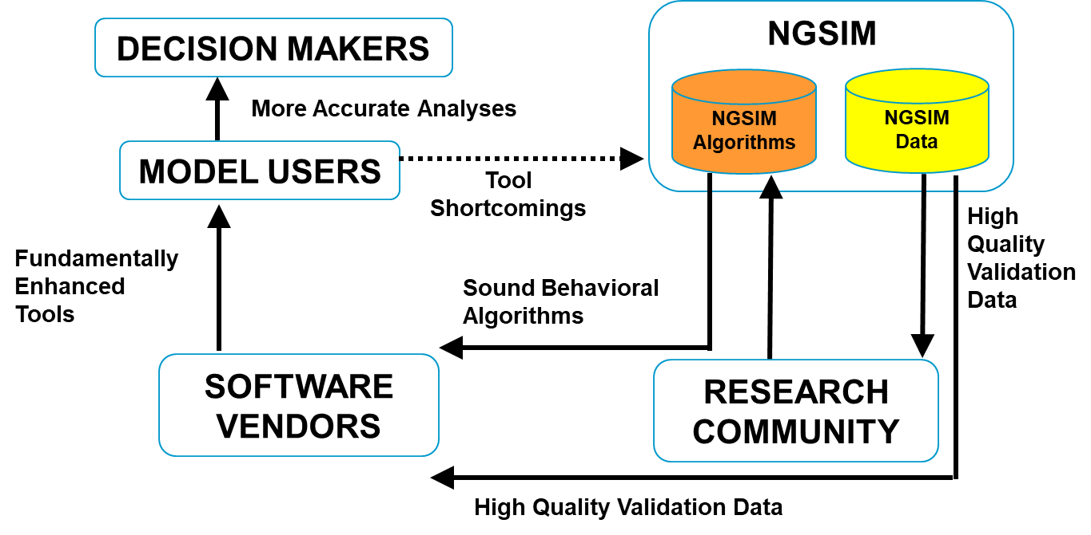
Envisioned NGSIM Impact: Enhanced Tools and Better Decision Support

Slide 6
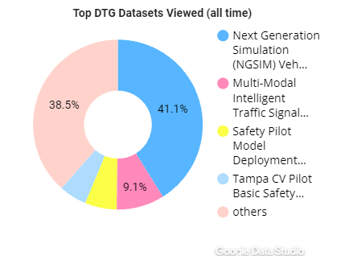

Decades Later: NGSIM Data Sets Continue to Generate Value
500+ TRB papers, conference presentations, and other documents citing NGSIM data
ITS Data Hub: NGSIM downloaded more than 140 times per month
NGSIM Data Story published on ITS Data Hub
https://data.transportation.gov/stories/s/i5zb-xe34
NGSIM designed as a one-off activity to change federal role and address 4 top concerns

Slide 7
22 Years After the NGSIM Community Workshop: What NGSIM Accomplished and What It Did Not
What NGSIM Accomplished
Created ITS AMS community cohesion around four key needed improvements
Transformed FHWA/USDOT from market competitor to market facilitator
Generated fundamental data sets of lasting value (algorithms/code less durable)
What NGSIM Did Not Accomplish
Did not result in a long-standing, self-organizing ITS AMS community, despite efforts to create one as the NGSIM program wrapped up
Did not result in a forum where a new list of prioritized projects/data collection efforts were updated
Federal maintenance required to keep data sets and meta-data available
Did not inspire others to contribute code or data outside of federally-funded efforts

Slide 8
Revisiting the Post-NGSIM AMS Market: Improved, But Neither Tools Nor Market Are “Perfect”
DECISION MAKERS
USDOT DataHub
Model Improvement
Efforts
New
Data
Better Analyses
Model Improvement
Efforts
Needs
Model Improvement
Efforts
NGSIM, TGSIM, and Other
Key AMS-Related Data
MODEL USERS
Guidance
Enhanced
Tools
High Quality
Validation Data
Issues
Needs
SOFTWARE
VENDORS
RESEARCH
COMMUNITY
“SOFTWARE DEVELOPMENT COMMUNITY”

Slide 9
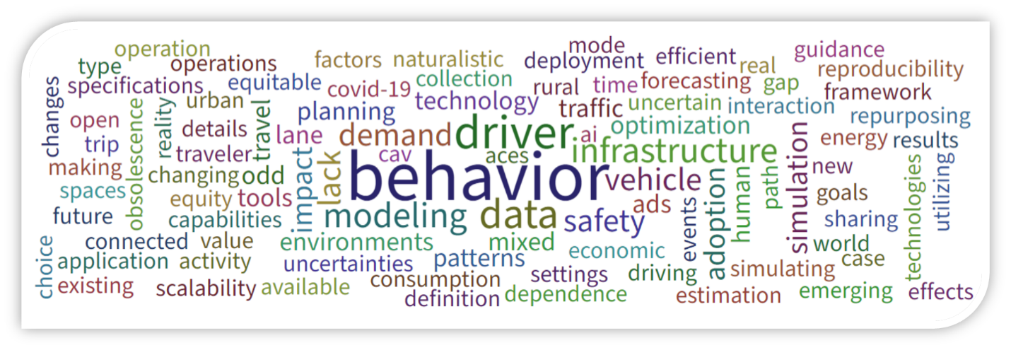
2023 Connected and Automated Vehicle AMS Workshops: Top Challenges
Many CAV-related AMS challenges identified, including
Driver behavior under various forms of connectivity and driving automation
Lack of data, but also concerns around managing large CAV-related data sets
Modeling realistic mixed CAV environments, including trip-making behavior impacts
Guidance on how to model given multiple layers of overlapping uncertainty

Slide 10
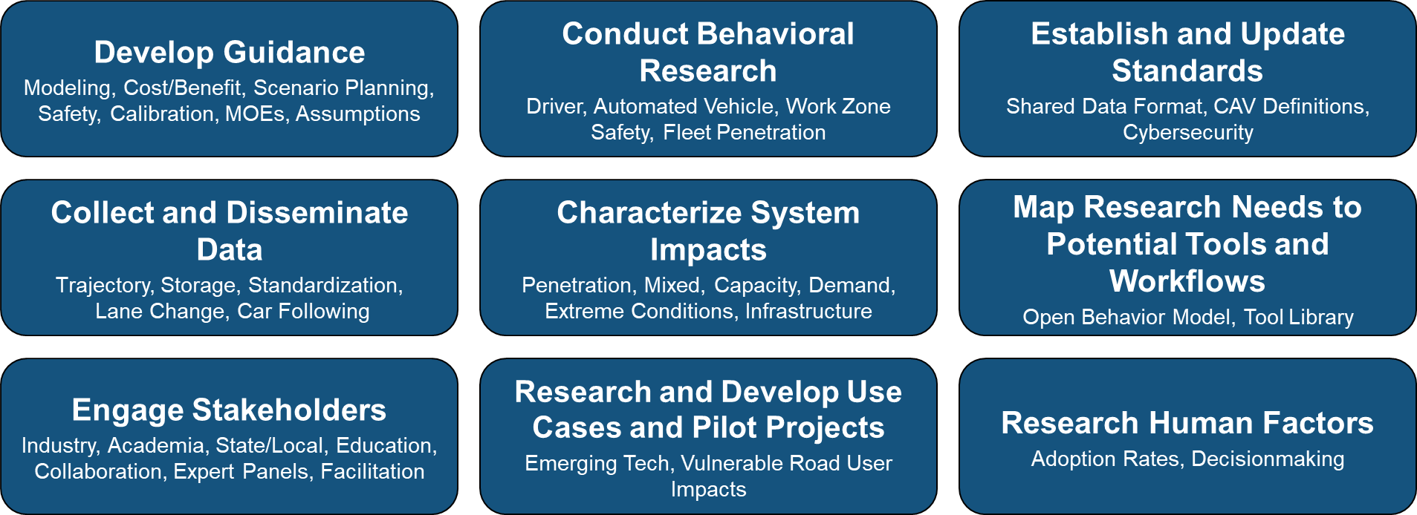
2023 CAV/AMS Workshops: Top Actions

Slide 11
22 Years After the NGSIM Community Workshop: ITS AMS Needs Summary
What Has Changed
More powerful compute platforms, more complex (and diverse) tools, a focus on AI/agentic modeling, increased data availability
Increased focus on vehicle connectivity and driving automation
Complexity of decision-making, difficulty of the ITS AMS “ask”
What Has Not Changed
Desire for more capable yet easier to use tools
A desire for “more” data, a focus on understanding and modeling “non-uniform” traveler and driver behavior in response to new technology and societal trends
A need to gain decision-maker trust in tools (and assumptions), heightened requirement to uncomplicate the complicated

Slide 12
Hypothesis: An Engaged ITS AMS Community Can Create Sustained Impact on CAV Needs
DECISION MAKERS
FHWA CAV AMS PROGRAM
meets annually
Better Analyses
Project 1
Prioritized
Needs
Needs
Project 2
CAV
AMS
Projects
CAV AMS Community
MODEL USERS
Project 3
CAV AMS
Community
Guidance
Project N
Enhanced
Tools
Case Studies,
Driver Models
CAV AMS Data
Needs
Issues
DataHub
SOFTWARE
VENDORS
RESEARCH
COMMUNITY
CAV AMS
Data
CAV AMS Data
“SOFTWARE DEVELOPMENT COMMUNITY”

Slide 13
Benefits of a CAV AMS Community Engagement
Prioritized assessment of AMS-related needs, updated annually
Rapid conversion of needs into actionable federal projects
Venue and mechanism for rapid sharing of CAV AMS guidance and best practices
Creates data sets of potentially lasting value, which the community can anticipate and rapidly access/utilize
Results in targeted case studies and behavioral research relevant to the CAV AMS software development community

Slide 14



Karl Wunderlich
Director, Surface Transportation Systems
Director, Autonomous Systems Research Center
Autonomous Systems | Noblis
Karl.Wunderlich@noblis.org
Visit noblis.org

